Slide 1
Department of Computer Science, COCIS
Makerere University
Lecturer: Ggaliwango Marvin
GRAPH ATTENTION MECHANISMS FOR MACULAR DEGENERATION DISEASE DIAGNOSIS USING SELF-ROUTING CAPSULE KNOWLEDGE DISTILLATION
OcuMed
Keywords: Age-Related Macular Degeneration, Optical Coherence Tomography, Graph Attention Networks, Capsule Networks, Knowledge Distillation, Vision Transformers
- ML-D-31 (GROUP 31)
- ABONYO MITCHELL NINA 23/U/0095
- NAKIGULI ELIZABETH GLORIA 23/U/13736/PS

Slide 2
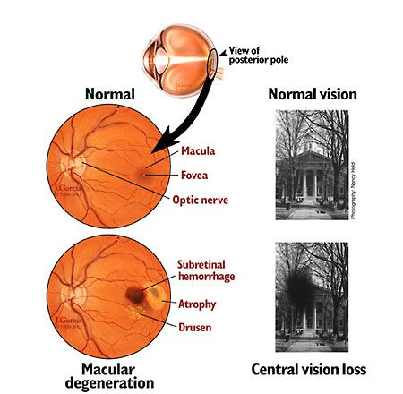
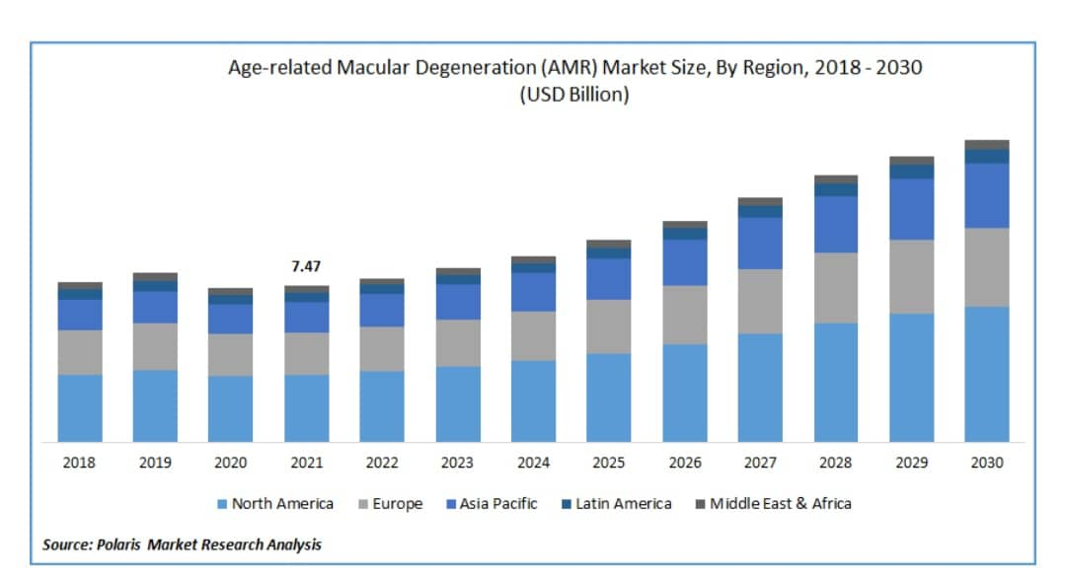
Problem Statement
Macular Degeneration, also known as Age-related Macular Degeneration (AMD), is among the leading causes of irreversible blindness in older adults worldwide.
Early detection is difficult due to the subtle nature of initial symptoms.

Slide 3
Project Objectives
Develop a machine learning model for the early detection of macular degeneration.
Improve diagnostic accuracy and speed of AMD.
Provide an accessible tool for medical professionals.
Increase diagnosis accessibility for patients in regions with limited healthcare resources.

Slide 4
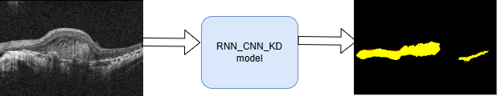
Solution Overview
Our project leverages deep learning techniques such as Vision Transformers, Graph Attention Mechanisms, Capsule Networks and Knowledge Distillation to design an AI-driven support system for ophthalmologists.
The system will analyse retinal OCT scan images to aid the early detection of AMD.

Slide 5
Data Used
We used a publicly available retinal image AMD-SD dataset.
It consists of 3049 Optical Coherence Tomography (OCT) images.
The images have a resolution of 570x380 pixels ensuring high detail for analysis.
Characteristic | Details
Dataset Name | AMD-SD Dataset
Number of patients | 138 patients
Number of Images | 3049 OCT B-scan images
Dataset Components | Images folder, Demographics file, Training text file, Validation file
Demographics considered | Patient ID, Eye ID, Eye category, Age, Sex, Time acquired

Slide 6
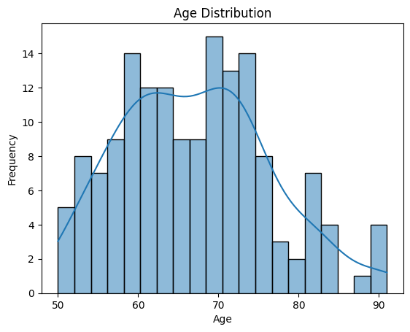
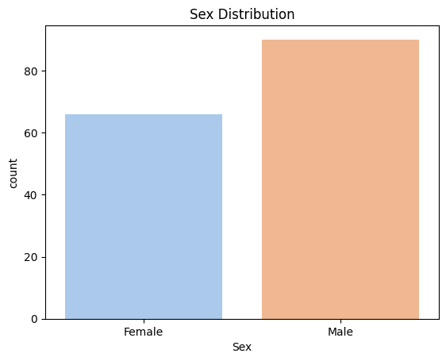

Slide 7
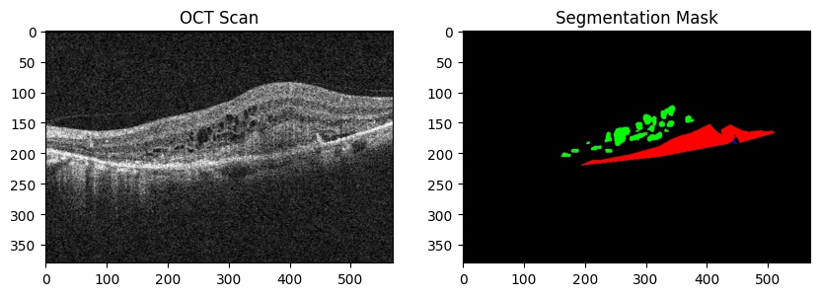

Slide 8
Models AND TECHNIQUES
MODEL | DICE SCORE | IoU | ACCURACY
U-NET | 0.81846 | 0.7891 | 0.9898
RESNET | 0.8854 | 0.8605 | 0.9943
U-NET_VITs | 0.78632 | 0.75848 | 0.9876
U-NET_GATs | 0.0009 | 0.0022 | 0.7844
RNN_CNN_KD | 0.9185 | 0.9637 | 0.9815
ATT_CNN_KD | 0.9186 | 0.9638 | 0.9816
U-NET++_CNN_KD | 0.9183 | 0.9634 | 0.9813
U-NET++_KD | 0.9799 | 0.9609 | 0.9801

Slide 9
WHY THESE TECHNIQUES?
Vision Transformers
Improve long-range dependencies in image analysis.
Enhance retinal layer segmentation for precise lesion detection.
Self-routing Capsule Networks
Enhance global feature extraction by integrating self-attention mechanisms.
Maintain structural information for better lesion detection.
Graph Attention Networks
Enhance segmentation, focusing on critical regions by treating OCT scan images as graphs.
Knowledge Distillation
Optimizes model size while preserving performance.

Slide 10
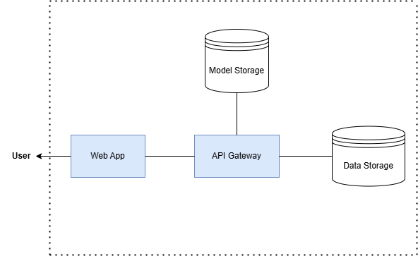
System Architecture

Slide 11
Implementation Details
Implementation Feature | Implementation used
Languages | Python
Libraries/Frameworks | TensorFlow
Platforms | Kaggle

Slide 12
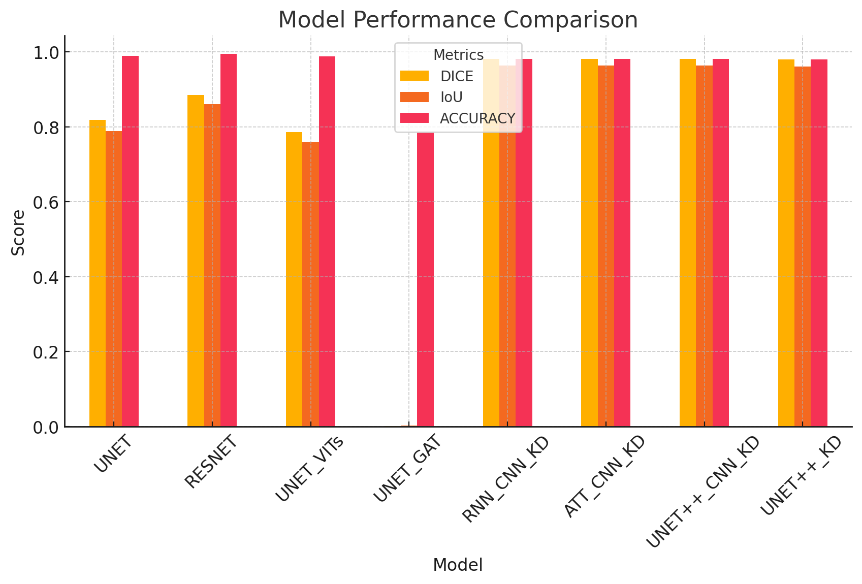
Results and Evaluation

Slide 13
Impact & Relevance
The target users and beneficiaries of our work are the doctors and healthcare professionals in hospitals and eye clinics, researchers, and public health organizations.
Our work aligns with some SDGs such as:
i) SDG 3 - Good Health & Well-being
ii) SDG 9 - Innovation and Infrastructure.
The expected benefits of our project include:
-Reduction in the blindness rates worldwide.
-Improved accuracy and speed in the diagnosis of AMD which can lead to better treatment planning.
-Improved and proper planning due to early detection of macular degeneration.

Slide 14
COMPETITIVE ADVANTAGE ANALYSIS
Competitor | Strengths | Weaknesses | How our system is different
Retina-AI Health(US) | Commercialized for hospitals | -Requires well equipped medical facilities. -Focuses on late AMD detection. | -Optimized for low-cost medical facilities -Promotes early AMD detection.
Eyenuk(US) | Used cloud-based AI | Requires high-quality images. | Supports the lower resolution images.

Slide 15
Monetization & Scaling
Market Application | Monetisation | Go-To-Market Strategy
Collaboration with hospitals such as Mengo Hospital. | Subscription-Based API (monthly or annually) | Pilot Program
Collaboration with eye clinics such as Georgina Eye Clinic. | Pay-Per-Scan | Marketing & Partnerships
Collaboration with research institutions such as Makerere University. | Licensing for Medical Devices | Investor Funding & Grants

Slide 16
Intellectual Property & Innovation
Protection Type | Element in System
Patent | AI algorithms and techniques used
 | Software Code Implemented
 | System architecture (ensures that AI algorithms seamlessly integrate within the hospital systems through the use of APIs)
Copyright | Source code
 | UI design
 | Associated Documentation
Trademarks | System/Brand name
 | System/Brand Logo

Slide 17
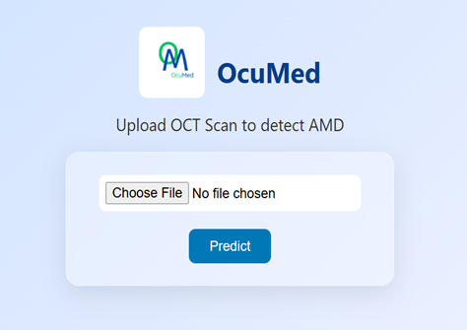
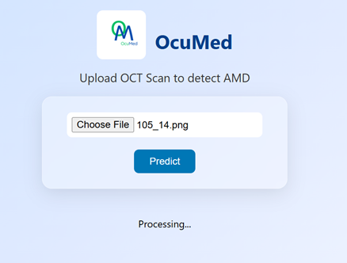
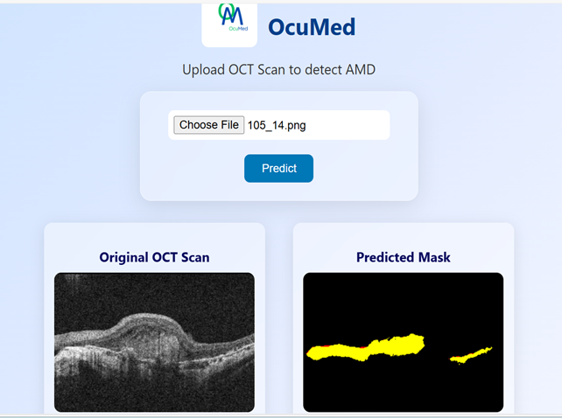
System Demonstration
Below are demo interface screenshots on how our model, once deployed would be applied in a real-world clinical setting:

Slide 18
Team Contributions
ABONYO MITCHELL NINA | NAKIGULI ELIZABETH GLORIA
Model training | Model training
Model deployment | Model evaluation
UI design | Preparation of necessary documentation

Slide 19
Lessons Learned & Challenges
LESSONS LEARNED | CHALLENGES
Model Interpretability through explainable AI is crucial | Model overfitting
Patience in trouble shooting | Deployment challenges
Iterative development is key | Scarcity of publicly available datasets

Slide 20
Future Work
Future efforts will focus on:
Deploying the model in real-world clinical settings to assess its practicality and impact on healthcare delivery.
Enhancing model accuracy with larger datasets.
Integration with electronic health record (EHR) systems in hospitals and eye clinics.
Developing a user-friendly application or website.

Slide 21
Conclusion
Our project demonstrates the great potential of Artificial Intelligence (AI) in transforming ophthalmology by providing an affordable and efficient AMD detection system.
The integration of Graph Attention Networks, capsule networks, knowledge distillation helped us develop a model with robust feature extraction and great interpretability to aid the early detection of AMD among people.
Future work will focus on enhancing model generalization by increasing dataset diversity and optimizing the model’s efficiency in order to contribute to the widespread adoption of AI in ophthalmology.

Slide 22
Thank You!
ABONYO MITCHELL NINA
Email: mtchllnina@gmail.com
NAKIGULI ELIZABETH GLORIA
Email: nakiguligloria5@gmail.com

